Slide 1
Modern Slavery
Supplier Training

Slide 2
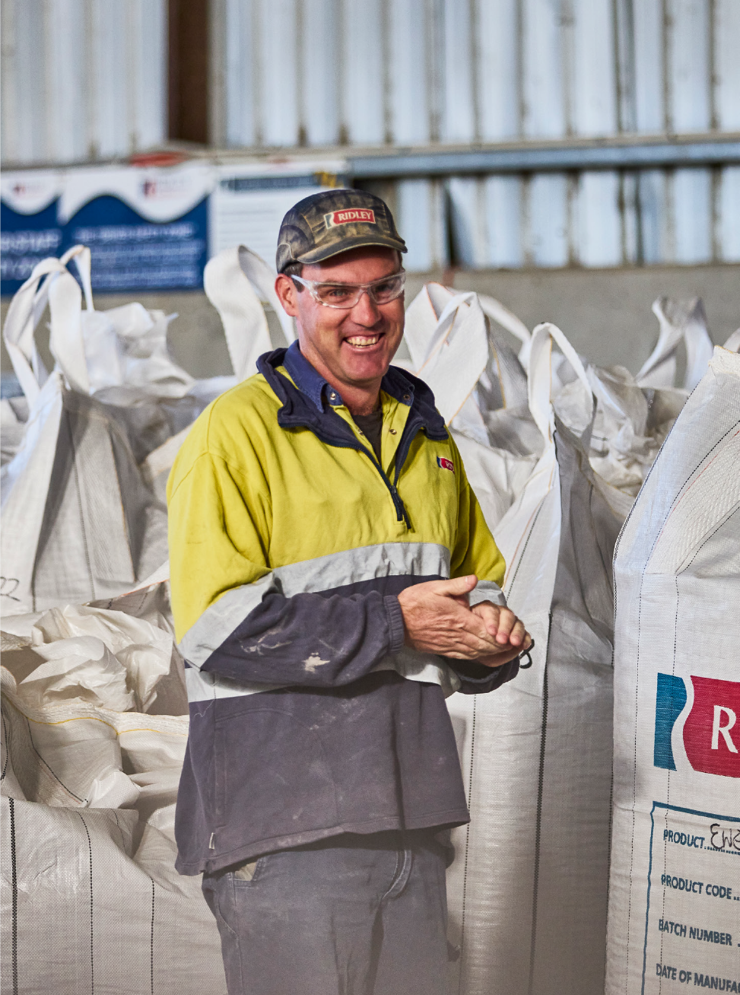

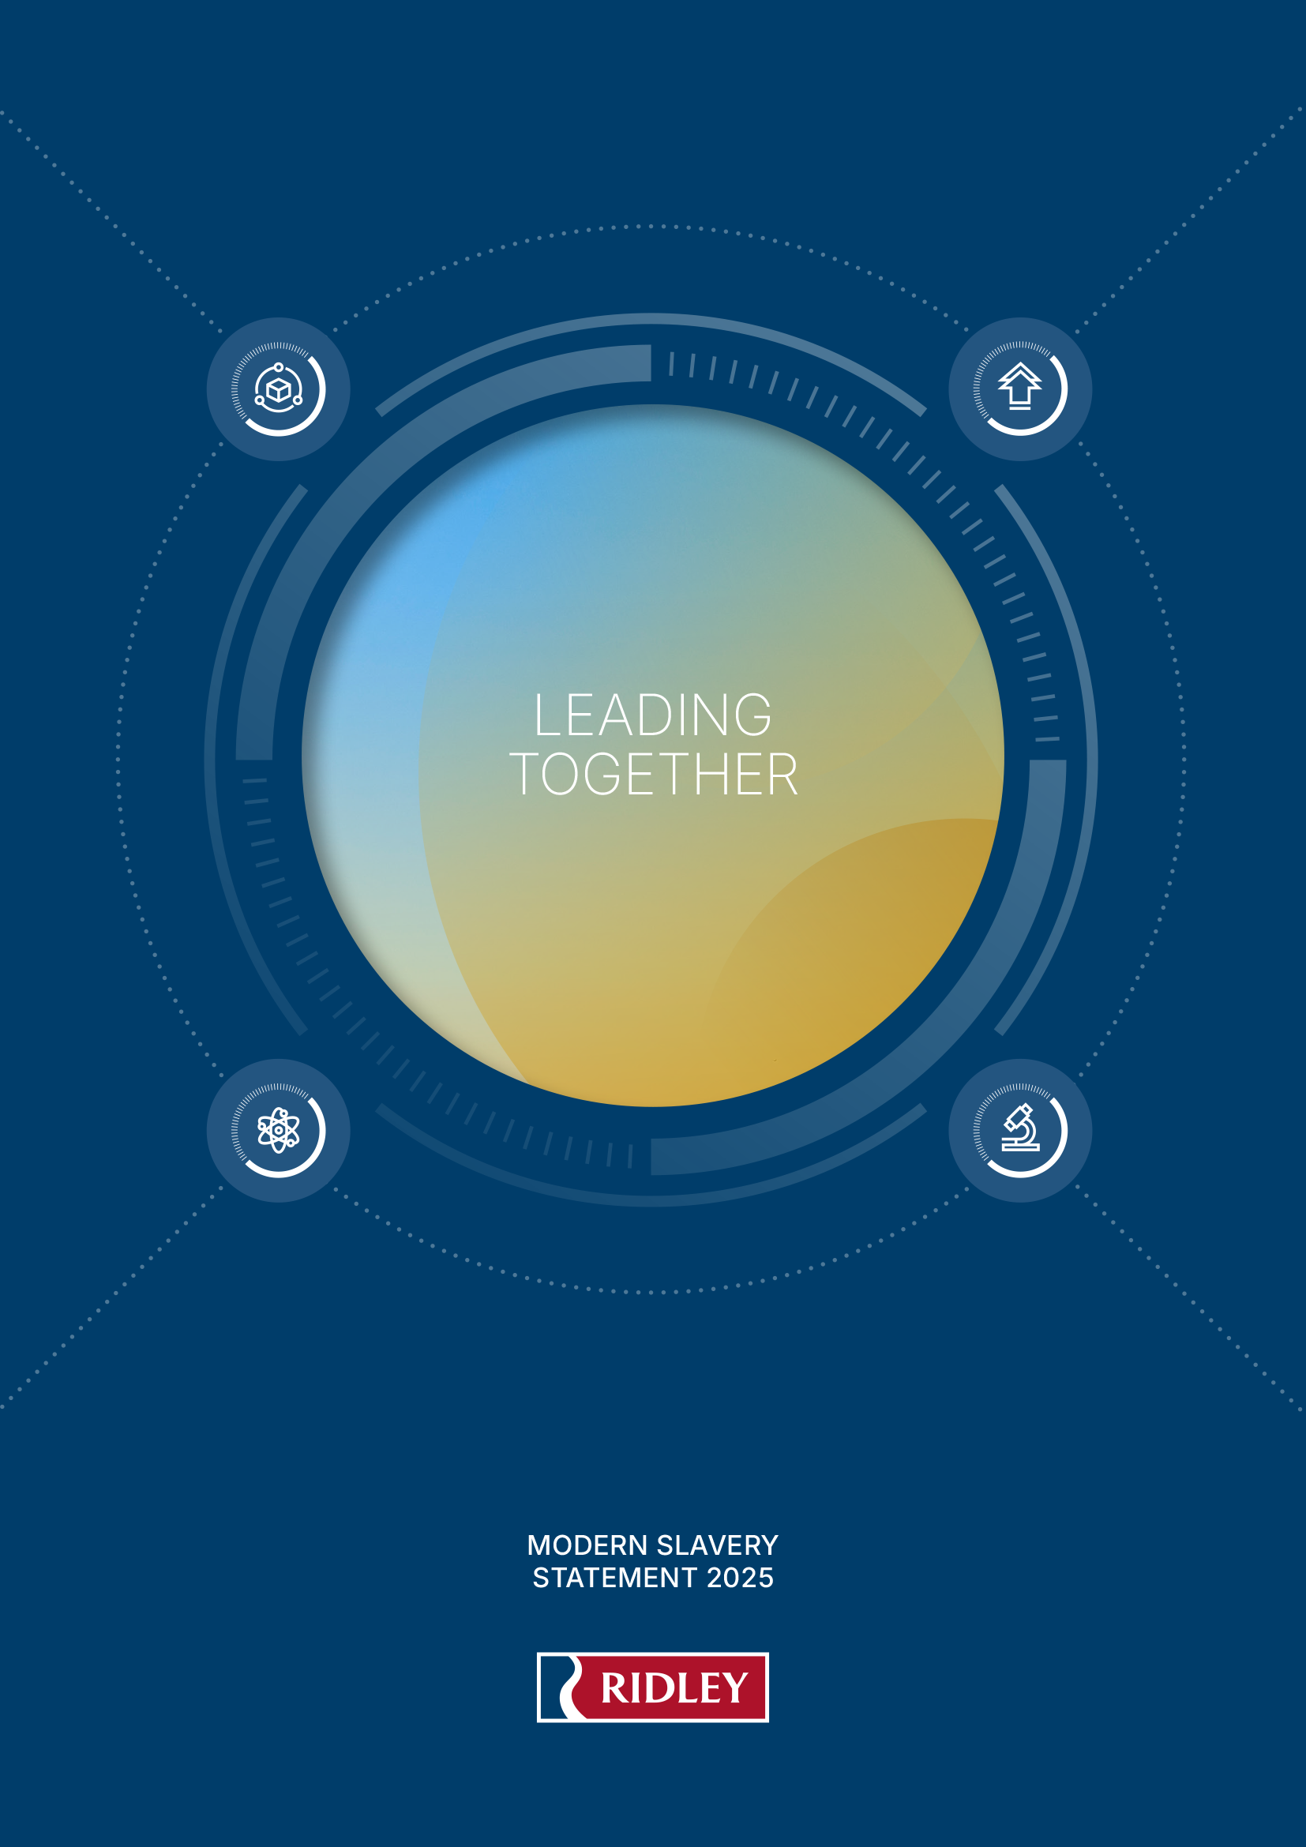
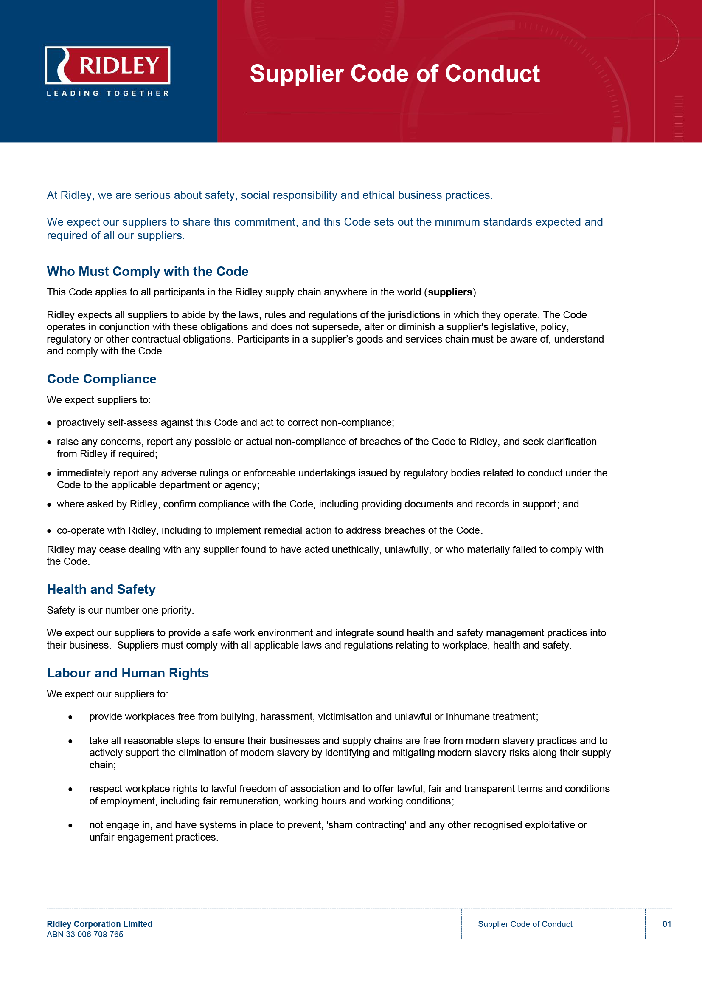

Help us to Eradicate Modern Slavery
At Ridley, we are serious about safety, social responsibility and ethical business practices. We respect human rights as being fundamental to our business and the communities in which we operate.
Ridley’s actions to identify and address all forms of modern slavery including human trafficking, forced labour and child labour both within our organisation and as part of our supply chain are set out in our Modern Slavery Statement and our Supplier Code of Conduct.
We expect all participants in the Ridley supply chain anywhere in the world to share this commitment and comply with our Supplier Code of Conduct.
The Code operates in conjunction with the obligations set out in this training and does not supersede, alter or diminish a supplier’s legislative, policy, regulatory or other contractual obligations.

Slide 3
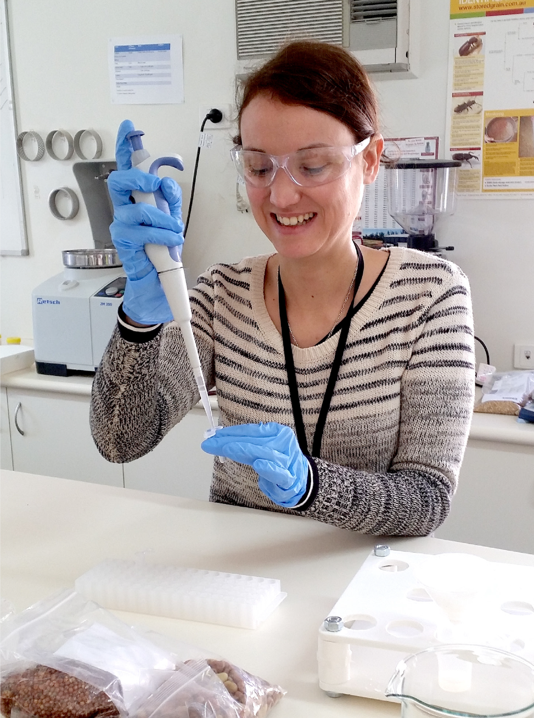
Modern Slavery in Australia
What is modern slavery?
Modern slavery is when someone is forced to work, or do other things through coercive means such as manipulation, control, violence, threats or lies. It involves exploitation of people for personal or commercial gain and takes away a person’s freedom to make choices for themselves.
Modern slavery takes many forms including forced labour, human trafficking, slavery, and debt bondage. It can occur in global supply chains and is often hidden and difficult to detect.
The United Nations has estimated that there are more than 40 million victims of modern slavery worldwide. The nature and extent of modern slavery means that every organisation has modern slavery risks in its operations and supply chains.
Notes:
Usage: Internal document (not for public domain)

Slide 4

Modern Slavery and the Law
Modern slavery laws mean any legislation applicable to your organisation with respect to reporting on and addressing the risks
of modern slavery in your operations and supply chains.
In Australia, there are laws that apply to modern slavery, including
the Fair Work Act 2009 (Cth), and Modern Slavery Act 2018 (Cth)
(the “Act”)which was passed by Australian Parliament on 29 November 2018. The Act established national modern slavery reporting obligations and requires large companies based or operating in Australia, including Ridley, to report annually on the risks of modern slavery in their operations and supply chains, and actions to address those risks.
There are international laws that may also apply to businesses that conduct trade globally, or that engage suppliers in other parts of
the world.
Notes:
Usage: Internal document (not for public domain)

Slide 5

Labour and Human Rights
We expect our suppliers to:
provide workplaces free from bullying, harassment, victimisation and unlawful or inhumane treatment;
take all reasonable steps to ensure their businesses and supply chains are free from modern slavery practices and to
actively support the elimination of modern slavery by identifying and mitigating modern slavery risks along their supply chain;
respect workplace rights to lawful freedom of association and to offer lawful, fair and transparent terms and conditions of employment, including fair remuneration, working hours and working conditions;
not engage in, and have systems in place to prevent, 'sham contracting' and any other recognised exploitative or unfair engagement practices.
Notes:
Usage: Internal document (not for public domain)

Slide 6


Identifying Risks of Modern Slavery
Understanding what modern slavery looks like, and signs that could suggest an organisation is engaging in modern slavery, may help you identify if modern slavery is happening in your organisation and your supply chain.
Manufacturing, agriculture and construction are high risk areas for modern slavery therefore we have set out some red flags below that you should look out for:
Excessively low prices and fast turnaround: These can be a sign that a supplier may be cutting corners and that their workers are at risk of low wages and are being subject to exploitation and modern slavery.
Suspicious payments to third parties: Payments to parties that seem unusual, such as a staff member having an obligation to pay
a third-party recruitment firm upon being awarded a job.
Inappropriate identification documents: Suppliers not having the appropriate right to work checks in place or in the case of your own staff, if they have withheld information relating to their identity, or have provided false documentation.

Slide 7

Identifying Risks of Modern Slavery
Inadequate work health and safety: Suppliers that do not provide the minimum safety standards for work, health and safety, including facilities, training and policies. Alternatively, if you are informed that staff are subject to poor living conditions or in situations where they do not feel safe or are subject to unsafe workplace incidents such as bullying, harassment and discrimination.
Undisclosed subcontracted work: Subcontracted work that is not disclosed, is lacking documentation or has limited process, may suggest a lack of visibility of your supply chain, and increase the risk of modern slavery.
Lack of policies and procedures: Lack of policies and procedures from your supply chain should be reviewed and considered.

Slide 8
Supplier Responsibilities
We expect suppliers to:
proactively self-assess their operations and supply chains and act to correct non-compliance.
raise any concerns, report any possible or actual non-compliance of breaches of the Supplier Code, and seek clarification from Ridley if required.
immediately report any adverse rulings or enforceable undertakings issued by regulatory bodies related to conduct under the Code to the applicable department or agency;
where asked by Ridley, confirm compliance with the Code, including the provision of documents and records in support; and
cooperate with Ridley, including to implement remedial action to address breaches of the Code.
What should suppliers do if they identify any possible or actual
non-compliance?
Report concerns promptly to Ridley
Maintain records and evidence
Seek continuous improvement and monitoring

Slide 9
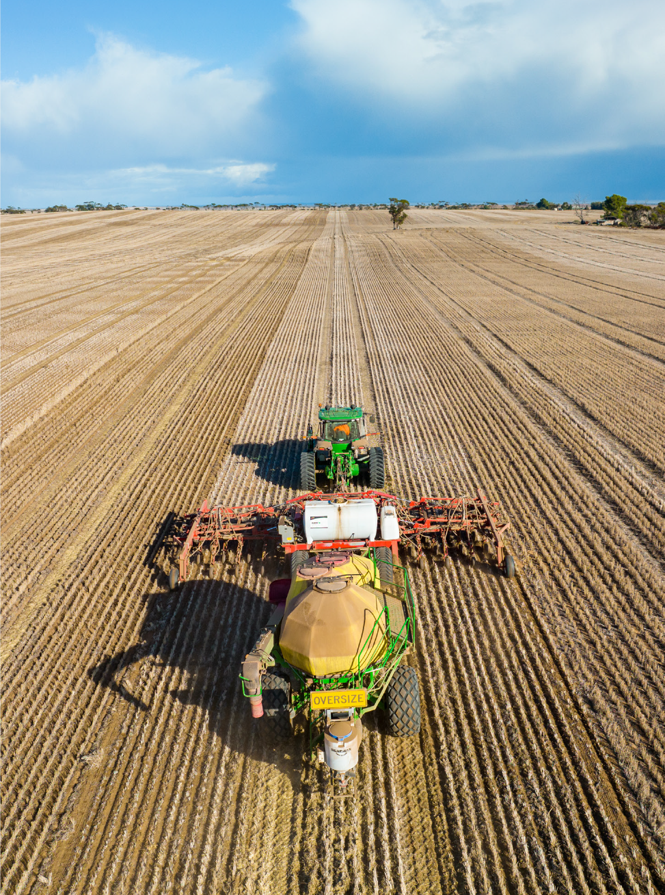
What should you do if you identify a risk
of modern slavery?
You can report a suspected instance of modern slavery relating to Ridley’s supply chain or your operations or supply chain as follows:
External report via Stopline: Stopline is independent of Ridley, and you may report anonymously
if you choose.
Australia Telephone (24 hours – Toll Free) | In Australia: 1300 304 550
Reverse Charge (Free to Caller) | Overseas: 02 5500 7307
Online | ridley.stoplinereport.com
Email | Ridley employees by email to ridley@stopline.com.au
Mail | Ridley c/o Stopline, PO Box 403, Diamond Creek, VIC 3089
Report to Ridley
If you are a Ridley employee – report a modern slavery concern to your supervisor. For other persons – raise your concern with your usual Ridley contact. Any personal information received by Ridley in relation to a report submitted will be held and used in accordance with Ridley’s Privacy Policy (www.ridley.com.au/privacy-policy).
Report via Ridley’s Speak Up Policy or to a Ridley Contact person (anonymously if you choose):
Internal (Ridley) Contact People:
General Counsel and Company Secretary | Email: Secretary@ridley.com.au
Chief People Officer | Webform: www.ridley.com.au/contactgmpeople
Chief Executive Officer and Managing Director | Webform: www.ridley.com.au/contact-ceo
Chair Audit and Risk Committee | Webform: www.ridley.com.au/chair-risk-audit

Slide 10
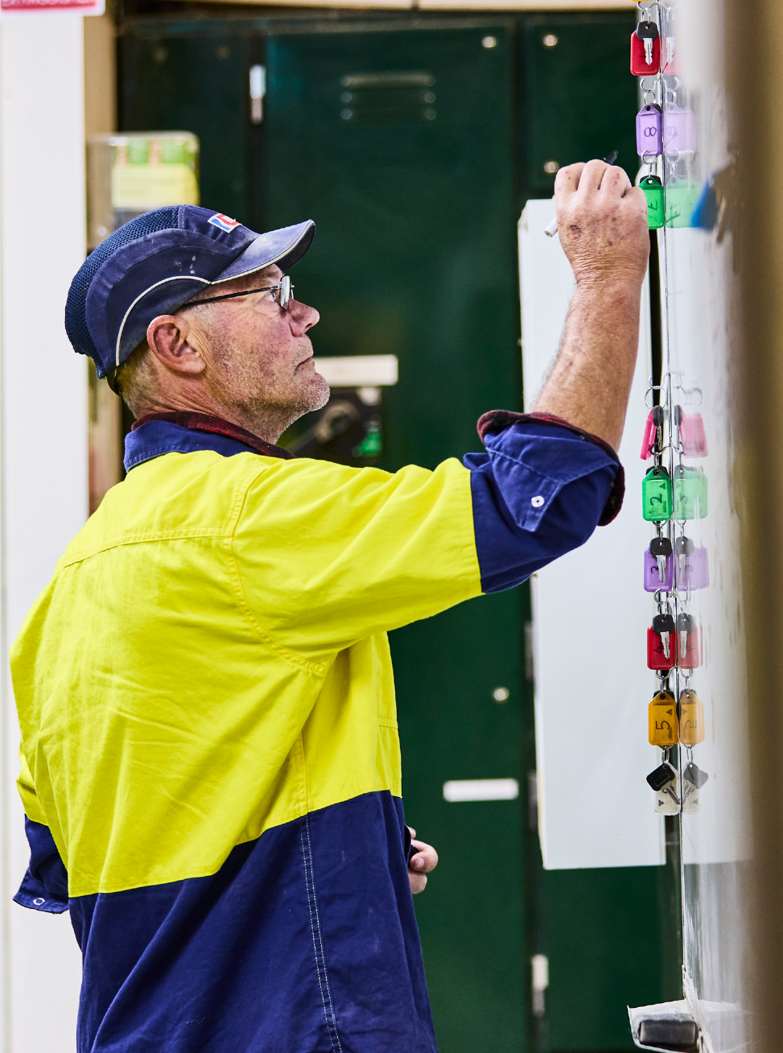
Supplier Responsibilities
  Suppliers should also:
  Implement policies and controls to identify, assess and address any risks of modern slavery within its operations.
  Conduct due diligence on each of its sub-suppliers.
Identify and mitigate risks of Modern Slavery within its operations.
Provide training and awareness to its employees, contractors and agents.
Cooperate with Ridley and other companies with audits and reporting.
Together, we can help make a difference. Thank you.

Slide 11

Knowledge Check Quiz [delete?]
1. What law governs modern slavery reporting in Australia?
A. Fair Work Act
B. Modern Slavery Act 2018
C. Corporations Act
2. Which is a red flag of modern slavery?
A. Overtime pay
B. Restricted worker movement
C. Flexible hours
3. What should suppliers do if they identify a risk?
A. Ignore it
B. Report and investigate
C. Wait for audits
Answers: 1-B, 2-B, 3-B)

Slide 12
THANK YOU

